Slide 1
Health Partnerships Capacity Development
Application webinar
10th March 2021

Slide 2
Webinar outline
Introduction to the programme & team running the programme
Key aims
Approach
Eligibility criteria
The application form
Timeframes
Questions

Slide 3
Introduction to the programme
The Health Partnership Capacity Development programme will work with Civil Society Organisations (CSOs) across the UK who are working in partnership with health institutions and those delivering health related projects in UK Aid Direct eligible countries.
The programme will strengthen the capacity and improve resilience of small international-focussed CSOs in the UK to deliver their strategic objectives through a comprehensive capacity development programme which will include participatory workshops and online tools and resources.
The programme will aim to enable eligible CSOs to better demonstrate their impact and successfully mobilise funds, thereby supporting increased sustainability and scale up of reach and impact.
This will benefit CSOs, their partners and beneficiaries.

Slide 4
Key objectives
To guide CSO's through the following areas
1. Strategic planning
2. Governance & Financial Competency
3. Duty of Care & Safeguarding
4. Digital Transformation
5. Project design and management
6. Monitoring, Evaluation & Learning
7. Gender Equality & Social Inclusion

Slide 5
Approach
A Holistic approach will guide successful applicants through a process to assess their capacity development needs which will be underpinned by THET’s Principles of Partnership.
This will enable the CSO's to draw up a development action plan.
Training workshops, an online community platform and a mentorship scheme will improve their capacity to deliver quality health partnership projects.
Each CSO will be assigned a mentor, who will support their development action plans and accompany them at intervals throughout the project to support them in achieving their goals. CSOs will be supported to establish active networks for learning and peer to peer support throughout the lifetime of the programme.

Slide 6
Eligibility requirements
The core requirements for applications are:
Applications must be made by CSOs who manage a health partnership between a UK health organisation and a LMIC health organisation, which is based in one, or more, of the countries identified in this Call. Partnerships are expected to demonstrate how each of the partners will actively engage in the programme.
Partnerships must involve an eligible country, as listed in the UK Aid Direct eligible LMICs
Applications must be made in English. Unfortunately, THET cannot accept applications written in other languages.
The majority of health partnership project activities must be carried out by volunteers.

Slide 7
Applicants must be Civil Society Organisations (CSOs) registered as a charity in the UK that work through a health partnership approach with an LMIC.
The UK CSOs must be registered with the relevant UK Charity Commission and have an annual income of under £400,000.
CSOs may be affiliated to a health delivery institution, health training/education institution, regulatory body, NHS arms-length body, professional membership association, academic institution, or diaspora led organisation.
CSOs not affiliated with health institutions including diaspora led organisations are also eligible to apply.

Slide 8
Capacity and duration
Roughly 12 hours per quarter of engagement
Programme runs from April 2021 – December 2022

Slide 9
What are we looking to see in the application form?
The partnership has outlined the challenges and weaknesses with their capacity to deliver projects, including challenges in project and financial management and monitoring and evaluation.
The partnership outlines how both partners will be actively engaged in this programme’s process.
CSOs should provide their latest annual return as logged with the appropriate Charity Commission highlighting where possible their annual income.

Slide 10
Process and Timeline
TIMEFRAME | STAGES
26 February 2021 | Call for Applications launch
10 March 2021 | Applications guidance webinar
31 March 2021 | Applications deadline
14 April 2021 | Applications selected
May 2021 | Training package begins
Expected commitment | 12 hrs per quarter
December 2022 | Capacity Development Project ends

Slide 11
Further support
Please read in detail:
Call for Application
Application form
All documents mentioned are on our website:
https://www.thet.org/get-involved/health-partnership-capacity-development-programme/
Feel free to contact us by email at: training@thet.org

Slide 12

Please join our online conference on the Friday 19th March!

Slide 13
Application form

Slide 14
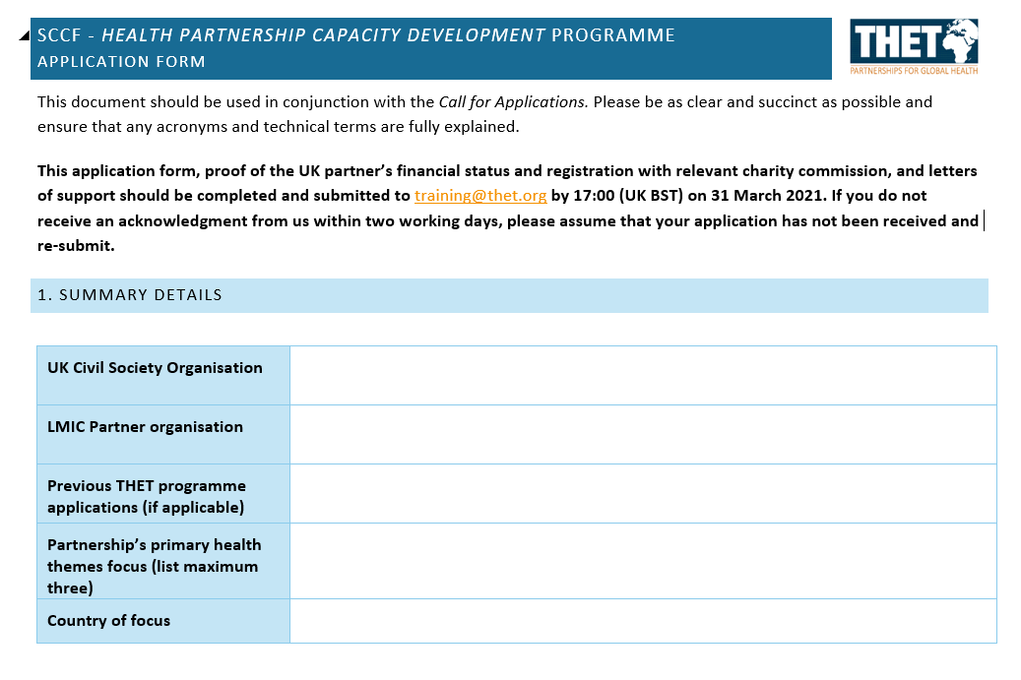

Slide 15
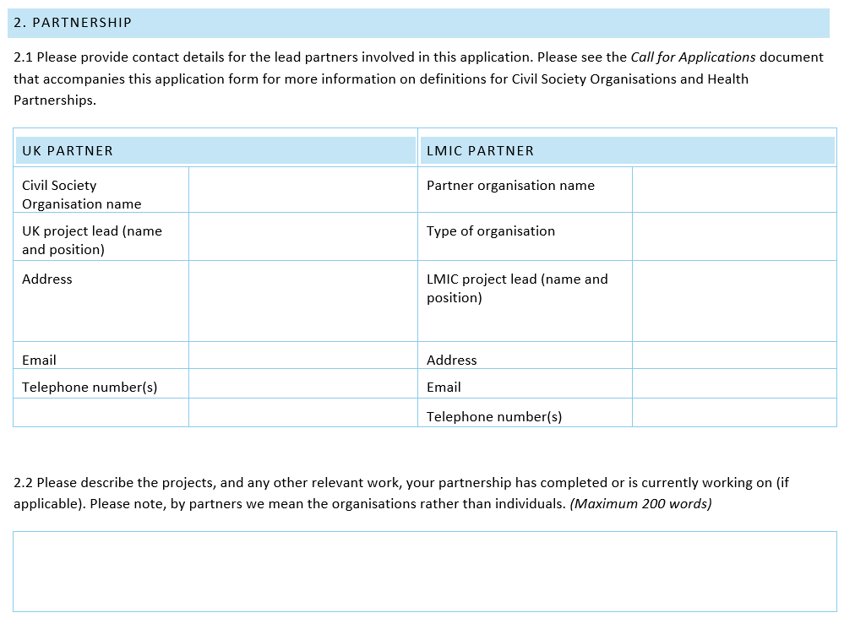

Slide 16
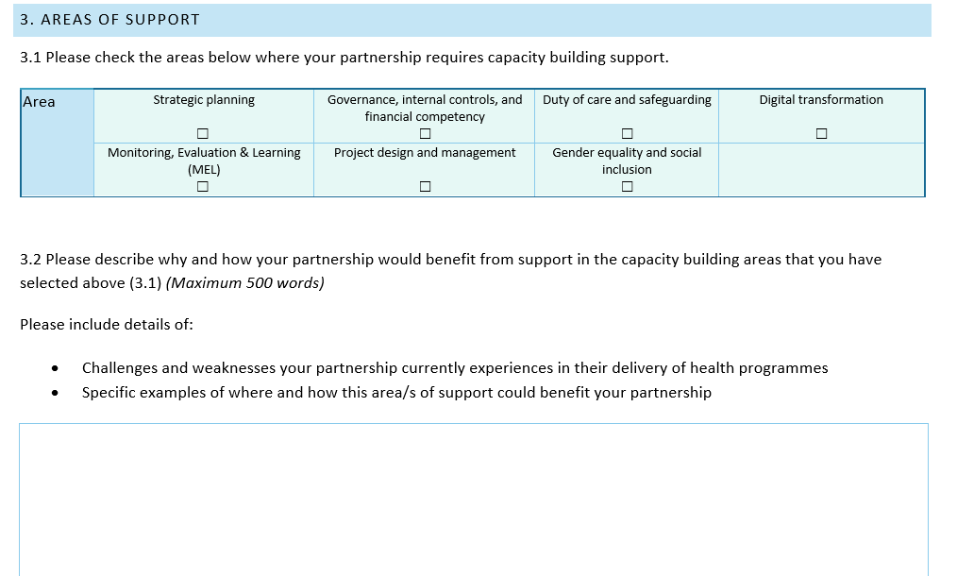

Slide 17
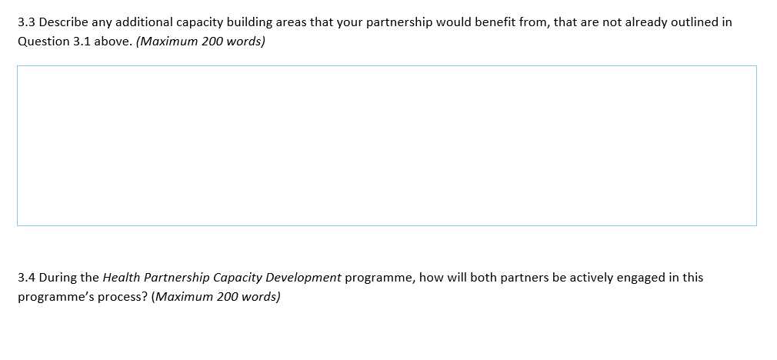

Slide 18
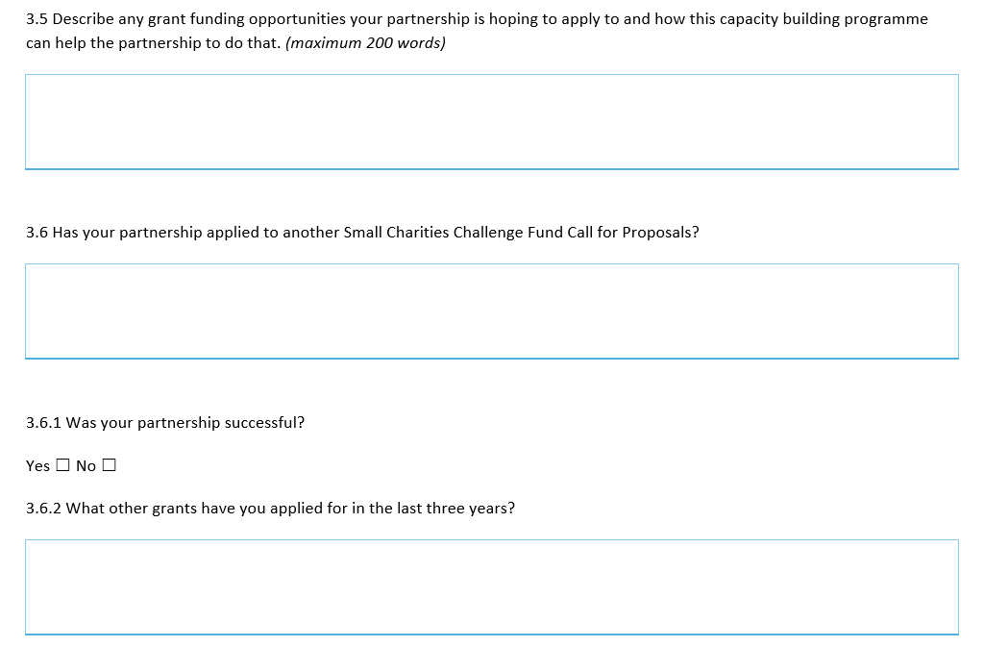

Slide 19
