Slide 1
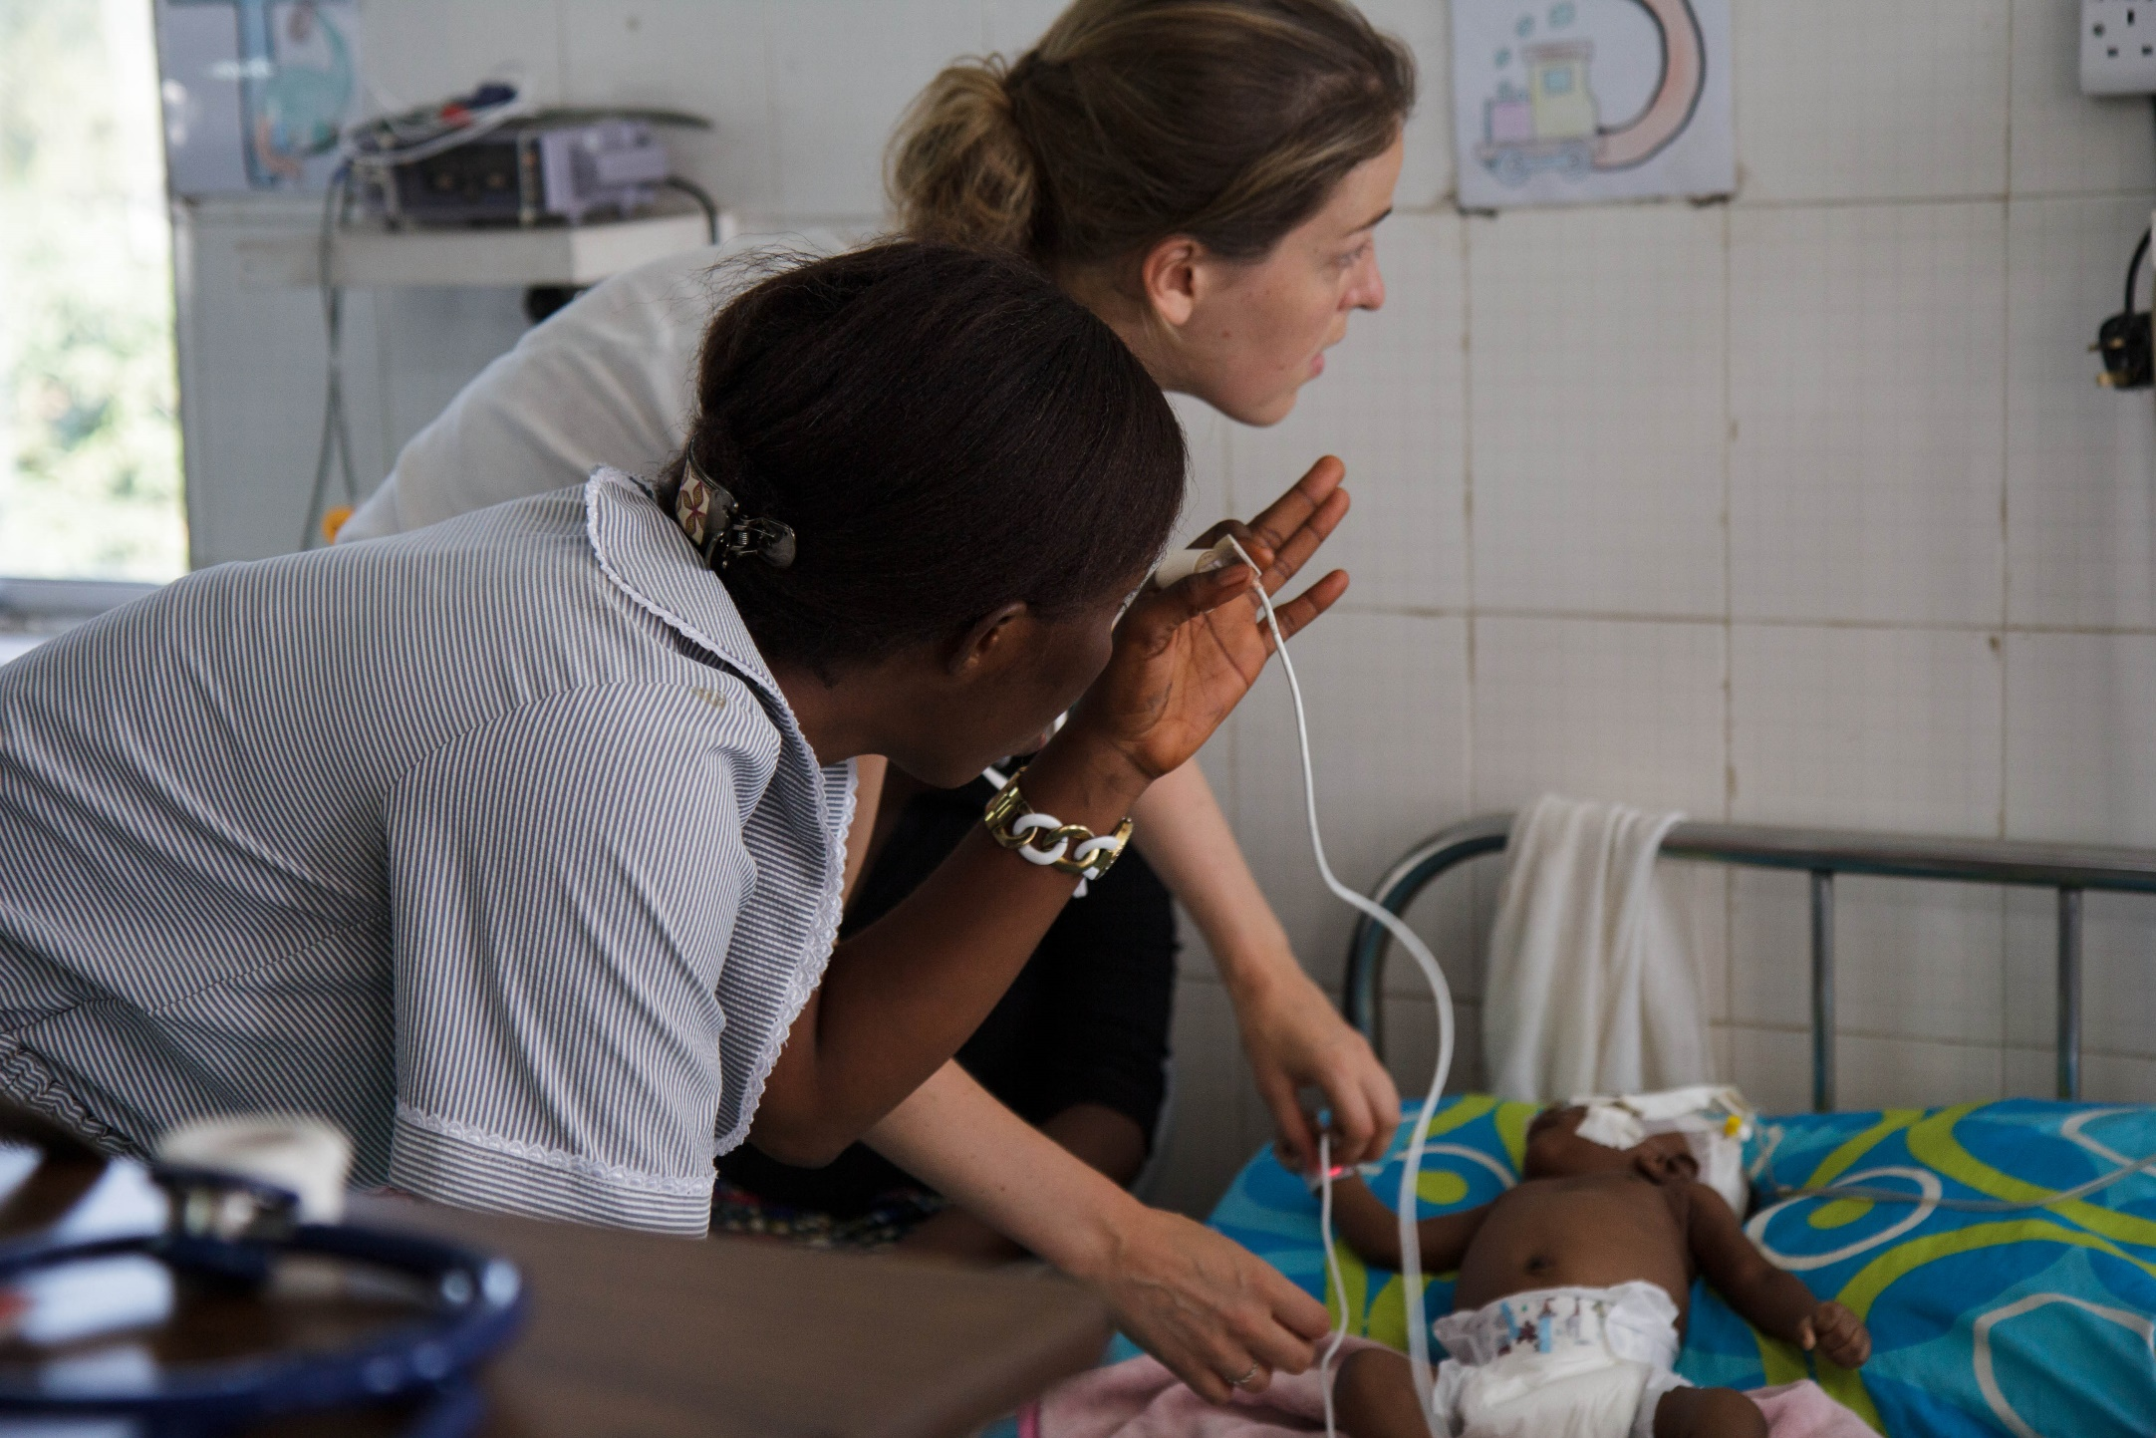


Nursing Now Challenge Fellowship
Programme Overview and Q&A session

Slide 2
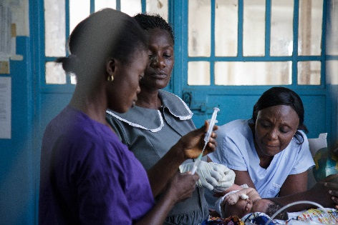
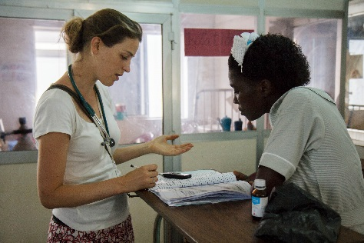
Today’s panel
Audrey Arbaud, Programmes Coordinator
Jessica Fraser, Programmes Coordinator
Programme manager: Nura Aided Ibrahim, Somaliland Country Director

Slide 3
Webinar outline
Introduction to the programme
Application process and timeline
Questions and Answers

Slide 4
Nursing Now Challenge Fellowship
Overall aim of the programme
To build the leadership of early-career nurses and midwives in selected countries in Africa and Asia, in alignment with the Nursing Now Challenge.
The Fellowship will engage early-career nurses and midwives, working through health partnerships, in low-and-lower middle-income countries (LMICs), sharing ideas with UK nurses and midwives.

Slide 5
Overall programme structure
40 to 80 early-career LMIC nurses and midwives, attached to established Health Partnerships
1 year Fellowship
Leadership training and technical training on Quality Improvement
Development and implementation of QI projects
Community of Practice, and Sharing/Learning events

Slide 6
Eligibility criteria
Established Health Partnerships
Operating in: Bangladesh | Ethiopia | Ghana | Myanmar | Nepal | Sierra Leone | Somalia/Somaliland | Tanzania | Uganda | Zambia
Early-career LMICs nurses and midwives (attached to established Health Partnerships)

Slide 7
What is an established Health Partnership
Health partnerships are long-term partnerships between UK institutions and their counterparts in LMICs.
The Lead partners can be:
a health delivery institution (e.g. an NHS hospital, a GP practice, a national hospital etc.), or
a health education institution (e.g. a College of Nursing or Midwifery etc.), or
a professional membership association (e.g. a Royal College, a Nursing Association etc.), including relevant regulatory bodies (e.g. a Nursing and Midwifery Council etc.).
Established Health Partnerships:
Have been working together for over 6 months,
Are formalised and institutionalised,
Can clearly demonstrate adherence to THET’s Principles of Partnership.

Slide 8
Funding available
Up to £8,000 per Partnership
Costs related to the QI project(s) – up to £700 per QI project
Costs related to admin/support and M&E – up to 40%
Data bundle costs (4 months)
Publication costs

Slide 9
Overview of application process
Submit application
Award
Programme starts
Application review
* Email your HP application form, nurses/midwives application form, nurses/midwives’ CVs and letters of support to grants@thet.org by noon on 4th October 2021
* If you do not receive an acknowledgement of your application within 2 working days, please re-submit your application
* Review of applications by THET and selection panel
* Due diligence assessments and requests for clarifications from applicants
* Grants and Fellowships awarded
* Contracting period
* Inception workshop and welcome pack
* Fellows will be enrolled and start the Fellowship from November 2021

Slide 10
Q&A Session
Please type your questions in the Q&A box

Slide 11
Further support
Please read in detail:
- Call for Application overview document
- Q&A document
All documents mentioned are on our website https://www.thet.org/our-work/grants/nursing-now-challenge-fellowship-programme/
You can also contact the project team by email at: GRANTS@thet.org

