Slide 1


Ghana Managed Education Partnership (MEP) Development
To support the decentralisation of healthcare training outside Accra and Kumasi with an initial focus on mental health
Summary slides including in-workshop feedback from Friday 12th July 2024
August 2024
NHS England, British High Commission Ghana
and Ghanaian stakeholder feedback
Notes:
Standard title slide

Slide 2
Introduction
This slide deck provides background on England’s national health service (NHS), NHS England and the
Managed Education Partnership concept.
It summarises information, options and discussions that took place during the NHS England technical visit
to Ghana between 8 – 12th July 2024.
A version of these slides were used as the basis for the Ghana Mental Health Managed Education Partnership
Feedback workshop that took place at the Nursing and Midwifery Council, Accra on Friday 12th July 2024.
This version of these slides have been updated to incorporate feedback from Ghanaian stakeholders during that
workshop.
We would ask all stakeholders to read through the feedback and provide any additional detail or comment
required. Feedback can be provided to england.tcc@nhs.net.

Slide 3
Contents
NHS England and the National Health Service (NHS)
MEP outline model
General scoping criteria
Observations on staffing and facilities
Wider context of MEP
Potential impact of MEP on:
  Patients (Summary of NHS England and Ghanaian stakeholders’ feedback)
  Organisation (Summary of NHS England and Ghanaian stakeholders’ feedback)
  Healthcare workers (Summary of NHS England and Ghanaian stakeholders’ feedback)
  Potential (Summary of NHS England and Ghanaian stakeholders’ feedback)
Timeline
Reflections
Next steps

Slide 4
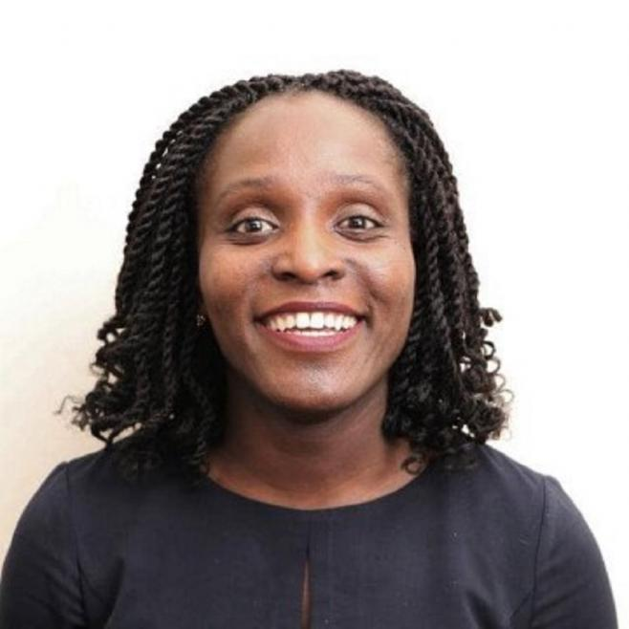
A short introduction
NHS England Scoping Team
Clare Kerswill, Project Lead, Global Health Unit
Ronke Akerele, Director of Culture Transformation, NHS England
Ian Wheeler, Head of PD&C, Global Health Unit
Nandini Chakraborty, Consultant Psychiatrist & National Lead for Recruitment in Psychiatry
Henrietta Bankas, Head of Portfolio, Blended learning and educator workforce strategy.
Michelle Thompson, Senior Lead NHS system capability
NHS England
Arm’s length body of Department of Health and Social Care, responsible for arranging provision of health services in England
The Global Health Unit sits within NHSE's Workforce, Education and Training (WTE) Directorate and we involve specialists from the organisation in our global work
The Global Health Unit is an accredited WHO Collaborating Centre for Human Resources for Health.
The WTE directorate is responsible for the strategic workforce planning, training and development for England's National Health Service.

Slide 5
The NHS: 76 years of Universal Health
Coverage
£192bn
Funding in 2020-21 by Department for Health and Social Care for health and care services (approx. 11.9% of GDP), including primary care services, ambulance, mental health, community and hospital services;
250,000
Patients attending an outpatient appointment each day
>1.3m
Staff in the NHS; 5th largest employer in the world. In June 2021 there were 123,727 doctors, 332,341 nurses, midwives and health visitors, and 33,907 managers
30,000
Calls to 999 each day
835,000
Patients attending primary care appointment each day. Primary care accounts for >90% of all NHS contact for 10% of the budget
50,000
Patients attending major A&E department each day; about 20% are admitted into hospital

Slide 6




NHS Long Term Workforce Plan- More and Different
NHS Providers
Embedding the right culture and improving retention
The Shelford Group, NHS Confed, Community Providers Network, NHS Employers, NHS Providers
Working Differently
Royal Colleges
Think Tanks
The Kings Fund, Health Foundation, Nuffield Health
AMRC, RCM, RCP, RCS, RCGP, RCPsych, RCoA, RCPath, RCOphth, RPS, RCSLT, RCEM
NHS England
DHSC
Long Term Workforce Plan (2023)
System Leaders
Education
ICS’ and provider chief Executives, Local Government Association
Council of Deans of Health, Medical Schools Council, Universities UK, University Alliance, Office for Students
Growing the Workforce

Slide 7

Retain - Embedding the right culture and improving retention
By improving culture, leadership and wellbeing, the aim is for 130,000 fewer staff to leave the NHS over the next 15 years.
The chapter on retain sets out how we will build on the People Plan and aim to make the People Promise a reality. This will be an additive process.
Enhance measures on Health and Wellbeing
Enhance evidence-based occupational health services for staff
Include provision for good rest areas for staff in workforce plans
Prioritise flexible and remote working
Use NHS Staff Passport and best practice on e-rostering
Use collaborative staff banks across systems
Work with government to ensure fair reward that will attract and retain the staff the NHS needs
Incentivise and facilitate leadership roles
Modernise the pension scheme
NHS People Promise
Provide education funding to ICBs
Commit to ongoing national funding for continuing professional development for staff
Support multidisciplinary team development across organisational boundaries
Deliver recommendations from the Messenger, Fuller and Kark reviews
Oversee delivery of the actions laid out in the new NHS equality, diversity and inclusion (EDI) improvement plan
NHS organisations will review their systemic cultures
Develop strategies on listening and freedom to speak up (FTSU)

Slide 8




International Retention
#StayAndThrive
‘Creating the conditions where internationally educated colleagues feel a strong sense of belonging, can thrive in their personal and professional life, whilst progressing in their careers’
National #StayandThrive community of action, an innovative transformation programme
The community has a shared purpose to educate, inspire and facilitate local employers to create conditions for internationally educated colleagues to thrive in their personal and professional lives.
Research has underpinned the community alongside improvement methodology to facilitate and embed continuous learning.
The community has enabled positive action and has helped, listened, involved, respected and learned from the contribution of those with lived experience.
Interventions have covered for example, change management, engagement, H&WB, reward/recognition and career development.
Progress and Impact
National network spanning 7 regions; Nurses, Midwives, AHP’s, Medics
7 learning events delivered with over 1000 attendees and 50 ‘drumbeat calls’ enabling the sharing of great practice
#StayAndThrive WhatsApp community.
9 Leading Inclusive Cultures Action Learning Sets
100% of participants in action learning sets agree that the programme has enabled them to explore their team culture, leadership style, values and beliefs. ​ ​
Direct support offers to providers, 123 bids for an innovation fund granted
Co-production of a bundle of international retention interventions
WeCommunities Twitter takeover reaching over 2,750,000
Notes:
Key areas of focus across the community have been around positive action to build belonging to include safe spaces, cultural awareness training and cultural event celebrations
Pastoral Care Quality Award promotion
Collaboration with NHS Employers: International Retention Toolkit: International Retention Toolkit | NHS Employers
#StayAndThrive Podcast series coming soon (in the Autumn)

Slide 9

Why work with a system?
System to System

Slide 10
What is a Managed Education Partnership?
MEPs facilitate the development of bilateral institutional health partnerships that seek to improve health service delivery and health outcomes
An MEP is co-created and co-developed with the local needs at the heart of the partnership
An MEP benefits both partners
Is a long-term and sustainable partnership
Complementary to other initiatives
MEPs generally consist of:
NHS organisation identified to partner with institution in partner country
Both agree mutually beneficial learning or development outcomes
Multi-directional knowledge and skill exchange takes place through placements or observerships in each country
Engagement with relevant national and government institutions
Reflexive practice

Slide 11
Managed Education Partnership on a page
Opportunities to collaborate with UK counterparts virtually, in Ghana & during study visits.
Reflexive practice – improving technical, professional and personal development.
Possible initiatives
  Study visits/observerships into to NHS partner trusts
  Action research or quality improvement projects aligned to programme priorities
  Formal qualification
Opportunities to collaborate with Ghanaian colleagues virtually, and in person.
Reflexive practice – improving technical, professional and personal development.
Possible initiatives
  Fellowships
  Action research or quality improvement projects aligned to programme priorities
Ghanaian
Institution(s)
NHS
Trust(s)

Slide 12
General Scoping Criteria
Patient
Organisation
Wider Context
Healthcare Worker
Patient need and carers/family/wider community Opportunity to improve patient centred care Civil society project/presence in relevant area | Demand from healthcare workers to participate Individual career/professional development and progression Improved retention/commitment to career Improved wellbeing | Leadership Culture Quality Improved retention within organisation Desire to collaborate Capacity to collaborate Capacity to support (pastoral aspects, supervision etc) Infrastructure to support (digital, facilities, amenities) | Alignment with wider Ghana health and educational priorities Complementary projects/programmes in area Evidence base? Consideration of: People Place Pathway English context to be able support
Potential for |  | Sustainability Scalability Flexibility Generalisability - not too niche
Notes:
Substance abuse
Distributed leadership / culture
Brain drain
Focus on blended learning not just observership; pay it forward
Place based care and community assets in LTWP?
Global community of practice - capture

Slide 13
Tamale
Ho
Facilities 10 in-patient beds (5 men, 5 women, 3 occupied at time of visit) Outpatient – 2 days a week Community work Community outreach – Twice a month for a couple of days, last time saw 300 pts. Multi-professional team. | Facilities Potential for 10 in-patient bed, but presently reliant on A&E admission or internal medicine Outpatient – 5 days a week Community work
Mental health staffing 1 consultant psychiatrist 2 psychiatrists in training (fellows in community and rehabilitation and addiction) 2 medical officers 36 nurses (7 in community) 1 psychologist about to start | Mental health staffing 2 psychiatrists (1 completed fellow, 1 fellow). 3rd psychiatrist (in C&A) recruited. 2 medical officers 12 nurses (1 community) 2 psychologists 1 mental health workers with BSc in community mental health
Other considerations: Psychological Medicine as name Early intervention, health promotion and prevention Court reports (no training) | Other considerations: Infrastructure Wellbeing of staff considered MhGap training Civil society link – Mental Health Advocacy Foundation Court reports (no training)
Notes:
Substance abuse
Distributed leadership / culture
Brain drain
Focus on blended learning not just observership; pay it forward
Place based care and community assets in LTWP?
Global community of practice - capture

Slide 14
Ankaful
Cape Coast
Facilities In patient - None currently, potential for in-patient space dependent on funding, admit to internal medicine ward if required Outpatient – 2 days a week Community work | Facilities 254 beds Out and Inpatient psychiatric care 24/7 Community psychiatry – 5 days a week Occupational therapy - 5 days a week Addiction rehabilitation services 24/7 Other services: General Medical Care, Reproductive & Child health services
Mental health staffing 1 psychiatrist (fellow in liaison psychiatry) 6 mental health nurses 2 psychologists | Mental Health Staffing 1 psychiatrist (Addiction fellowship trainee) 6 psychiatric residents (2 returning in September 2024, 2 in 2025, and 2 in 2026). 7 medical officers 1 part-time clinical psychologist (2 staff in training and expected back in 2025) 138 mental health nurses 2 mental health nurses in specialist training in Adolescent mental health care, to return in 2025 4 community mental health officers
Other considerations Community mental health nursing course Court reports (no training) | Other considerations Strong interest in forensic psychiatry, could be a centre of excellence Experience in court report writings Should be visited by any follow up NHS England delegation.

Slide 15
Cape Coast, Ho and Tamale
Wider Context
All opportunities will be an excellent fit with the Ghana National Human Resource for Health Policy and Strategies.
Mental Health Authority and Ministry of Health buy in
On English side, fits well with retention strategies, particularly the People Promise.
Career Development
Potential to influence the availability/development of combined/integrated membership and academic qualifications.
Potential to influence career development and pathways for Community mental health nurse officers (non-registered)
There are a number of complementary programmes and projects, e.g. :
  The Mental Health Training Program (MHTP): implemented by the Ghana Health Service with support from the UK Department for International Development (DFID), focuses on training psychiatrists, psychiatric nurses, and other healthcare providers;
  THET/Royal College of Psychiatrists: focus on the development of sub-specialty exposure for Psychiatry trainees under the auspices of the Ghana College of Physicians and Surgeons.
Notes:
Substance abuse
Distributed leadership / culture
Brain drain
Focus on blended learning not just observership; pay it forward
Place based care and community assets in LTWP?
Global community of practice - capture

Slide 16
Cape Coast, Ho and Tamale
Patient
NHS England observations, slide 11
Ghanaian Stakeholder feedback, slide 12
Notes:
Substance abuse
Distributed leadership / culture
Brain drain
Focus on blended learning not just observership; pay it forward
Place based care and community assets in LTWP?
Global community of practice - capture

Slide 17
Cape Coast, Ho and Tamale:
NHS England Observations
Patient
Demand for care is rising
Young population means that there are growing mental health issues including psychosis and drug use
The mental health issues arising from an older population continue to grow including dementia.
We have observed small outreach functions in settings
Outpatient care is the largest area of care.
Stigma
Role of family is really important, and they are more involved in care. For instance, due to a lack of inpatient beds, families might be more involved in acute care
Presence of traditional faith healers and other routes explored before arriving at mental health (last resort)
Growth in hospital presentations from 18-25 age group. Under – 18s by family health/psychologists in education settings.
Notes:
Substance abuse
Distributed leadership / culture
Brain drain
Focus on blended learning not just observership; pay it forward
Place based care and community assets in LTWP?
Global community of practice - capture

Slide 18

Cape Coast, Ho and Tamale:
Ghanaian Feedback
Patient
Anxiety and depression cases – are usually seen in primary healthcare. Generally, more psychosomatic presentations.
Faith-based healers or primary healthcare often used to treat anxiety and depression. Although they deal with treatment well, it is unclear how they achieve results so no methods backing it. They also provide social support.
Faith-based healers would like to improve links into formal health system, e.g. would send patients to primary care first and then treat in the community.
Traditional bed attendants to recognize red flags and escalate to next level, e.g. example given of this working in an O&G setting.
Younger patients tend to self-refer, whereas older patients are usually referred by health professionals.
The UK could learn about faith-based healing potential with communities. Potential to link up with chaplaincies in NHS Trusts?
Lay members of Psychological Council are often priests. They are being trained to support mental health issues.
The 3 facilities visited are tertiary, meaning patients have to go through 2 previous steps to be referred to this level, so mostly dealt with at earlier levels (anxiety, depression). It seems to work well.
Faith-based healers are often first and last call. Engagement with them is essential to provide training and they are now starting to realise the need for and provide better care.
Opportunity to link up with major prisons and prison hospitals (e.g. Ankaful)?
Notes:
Substance abuse
Distributed leadership / culture
Brain drain
Focus on blended learning not just observership; pay it forward
Place based care and community assets in LTWP?
Global community of practice - capture

Slide 19
Cape Coast, Ho and Tamale
Organisation
NHS England observations, slide 14
Ghanaian Stakeholder feedback, slide 15
Notes:
Substance abuse
Distributed leadership / culture
Brain drain
Focus on blended learning not just observership; pay it forward
Place based care and community assets in LTWP?
Global community of practice - capture

Slide 20
Cape Coast, Ho and Tamale:
NHS England Observations
Organisation
General hospitals
Teaching Hospitals
Desire to collaborate
Mental health services and offers increasing in importance and being rapidly developed.
Senior buy in
Variable infrastructure between different sites. Improved infrastructure will require significant funding.
Different approach to supervision between England and Ghana.
No specific population served; in some areas patients come from across borders. Difficult therefore to assess or predict demand.
Desire to continuously improve and provide evidence-based care.
Limited discussion around digital and technology
An appetite to collaborate on research
Notes:
Substance abuse
Distributed leadership / culture
Brain drain
Focus on blended learning not just observership; pay it forward
Place based care and community assets in LTWP?
Global community of practice - capture

Slide 21
Cape Coast, Ho and Tamale:
Ghanaian Feedback
Organisation
Potential for creation of Centres of Excellence in Ghana by specialisation (e.g. Ankaful, forensic)
Occupational Therapist is not always required: NHS England examples given of hiking and gym groups supporting people with mental health issues as well employment support working in early intervention of psychosis.
Research shows that in Tamale, anxiety and depression are in the top 5 of presentations. Interaction with primary care providers, but they miss a lot. Instances of referrals with typical text book signs. So are a lot of walk ins. Keen to gain evidence base to understand this more.
Pharmacists should be involved. They are often the first point of intervention (e.g. they meet drug addicts). Not very structured here presently.
Close links with social workers are necessary.
There was an activity room in Ho that is currently unused.
Notes:
Substance abuse
Distributed leadership / culture
Brain drain
Focus on blended learning not just observership; pay it forward
Place based care and community assets in LTWP?
Global community of practice - capture

Slide 22
Cape Coast, Ho and Tamale
Healthcare worker
NHS England observations, slide 17
Ghanaian Stakeholder feedback, slide 18
Notes:
Substance abuse
Distributed leadership / culture
Brain drain
Focus on blended learning not just observership; pay it forward
Place based care and community assets in LTWP?
Global community of practice - capture

Slide 23
Cape Coast, Ho and Tamale:
NHS England Observations
Healthcare worker
Passionate staff
Desire for specialisations
There is a basis for a strong leadership base in institutions we have visited
Newly qualified staff are given a wide breadth of responsibilities
Multi-professional
Enthusiasm from all areas of the workforce to have some participation in the programme.
A desire from a broad range of the workforce in mental health (clinical and non-clinical) to engage.
Few consultants and specialists.
Multi-disciplinary teams.
Desire for continuing professional development
Not always clear colleagues felt valued
Those with leadership responsibilities at all levels and places could be developed.
No occupational therapists
Wellbeing of staff awareness in Tamale
Notes:
Substance abuse
Distributed leadership / culture
Brain drain
Focus on blended learning not just observership; pay it forward
Place based care and community assets in LTWP?
Global community of practice - capture

Slide 24
Cape Coast, Ho and Tamale:
Ghanaian Feedback
Healthcare worker
Many healthcare workers are overworked and feel undervalued.
There is a need to develop social welfare process (social care). When community nurses visit, it makes a big impact and helps patients to feel valued.
MhGAP training in Volta Region provided. After one week of training, other colleagues were suspicious of new skills learnt and not inclined to support.
Look at building digital capacity – e.g. guidance around patient sensitive info, what can be designed for these settings, etc. would be helpful with distances and need etc.
They feel compelled to keep going and have a desire to make an impact.
Upskilling of certain areas - social prescribing in university curricula and public health pharmacy, mental public health etc. may help with retention.
Community mental health check for GHC - has resulted in a very medicalised curricula. It would be better if it were wider ranging and considered e.g. diagnosis, prescribing measures, holistic things like walking, employment assistance, etc. A full curriculum review would be useful.
Longstanding School of Social Work. Every district has a social worker but it is a bit disjointed. Could be better coordinated and resourced.
Feel there is a lack of support from policy makers.
At a community level, clinical vigilance course led by WHO in patient safety centres. WHO training centre in Accra could be involved.
Complexity of task shifting means that patients miss out.
Lack of supervision is a real issue. Maybe tech would help, e.g. Balint groups. Could do peer supervision.
Leadership - fellows in training will usually start or complete fellowships, then are immediately expected to lead which is a challenge.
Notes:
Substance abuse
Distributed leadership / culture
Brain drain
Focus on blended learning not just observership; pay it forward
Place based care and community assets in LTWP?
Global community of practice - capture

Slide 25
Cape Coast, Ho and Tamale
Potential
NHS England observations, slide 20
Ghanaian Stakeholder feedback, slide 21
Notes:
Substance abuse
Distributed leadership / culture
Brain drain
Focus on blended learning not just observership; pay it forward
Place based care and community assets in LTWP?
Global community of practice - capture

Slide 26
Cape Coast, Ho and Tamale:
NHS England Observations
Potential
Participants from all 3 of Cape Coast, Ho and Tamale should be encouraged as well as Ankaful.
We think this would benefit everyone and help to balance potential service needs whilst participants in England on ~8-week observership
Multi-professional participation strongly encouraged. To consider if specific cohorts are multi- or uni-professional.
Thoughts around specialisation by region...
Consideration of supportive virtual activities, e.g. communities of practice, action learning sets
Notes:
Substance abuse
Distributed leadership / culture
Brain drain
Focus on blended learning not just observership; pay it forward
Place based care and community assets in LTWP?
Global community of practice - capture

Slide 27
Cape Coast, Ho and Tamale:
Ghanaian Feedback
Potential
Some resources from the NHS and think tanks such as the King’s Fund are freely available and can be shared and used immediately.
Specialties – Cape Coast mentioned leadership and governance.
Consideration of pastoral care needed.
To support forensic training programmes, could be across all cadres.
Value comes from patients, not employer.
Keen to have the ability to demonstrate and share learning to others on return to Ghana.
Keen to explore opportunity to do professional and academic training concurrently.
Henrietta Bankas is presenting at Parish Nurses conference in September (similar to Christian Health Association of Ghana).
Multiprofessional – at district level, keen to involve nurses. Consideration to be given on how opportunities will be extended to them, especially in the community.
Consideration of academic institution outside Ghana – including in UK.
Notes:
https://www.kingsfund.org.uk/

Slide 28
Summary
Care Area | Specialties | Themes | Issues to consider
In-patient | Early Intervention in Psychosis | Prevention / Early Detection | Digital / Technology
Community – Health promotion / treatment | Substance Misuse | Workforce Education and Training | Training Infrastructure
Schools / Universities | Care of the Older Adult | Infrastructure | Clinical Infrastructure
 | Forensic Psychiatry | Retention | Supervision
 | Child and Adolescent Mental Health |  | Pastoral Care
 | Liaison Psychiatry |  | Learning across a continuum- floor to board
 | Rehabilitation Psychiatry
 | Community Psychiatry

Slide 29
Illustrative Managed Education Partnership observerships over 3 years
Appoint NHS delivery partner
Autumn 2024
March 2025 - TBC
To UK observership 1
April – June 2025
Follow up visit
Virtual interactions
To UK observership 2
July - September 2025
October – December 2025
Virtual interactions
–January - March 2026
April – June 2026
Virtual interactions
–July – September 2026
To UK observership 3
To UK observership 4
And repeat….
October - December 2026
January 2027 – March 2028

Slide 30
Reflections from all on feedback

Slide 31
Next Steps

Slide 32
Next Steps
We re-grouped on Friday 12th July and discussed with you the potential shape(s) for the MEP we have discovered during our travels between 9 – 11th July.
Together, we have considered how best to develop the opportunity (ies)
Following our return to England, we are in the process of creating a specification for the Managed Education Partnership and will invite NHS mental health trusts (groups of hospitals) to apply for the opportunity. We will ask Ghanaian colleagues to help select the successful NHS partner.
Later in the year, we should know who our NHS delivery partner is.
We intend to have a follow up scoping visit including the NHS delivery partner, ideally early in 2025 with exchanges beginning later in the year.
Regular stakeholder meetings with stakeholders in Ghana to keep everyone updated on progress

Slide 33
Next Steps Post Visit
We would ask all stakeholders to read through the feedback and provide any additional detail or comment required. Feedback can be provided to england.tcc@nhs.net.
We will look to set up steering and reference groups with the first meeting(s) intended to take place in September or October 2024.

Slide 34
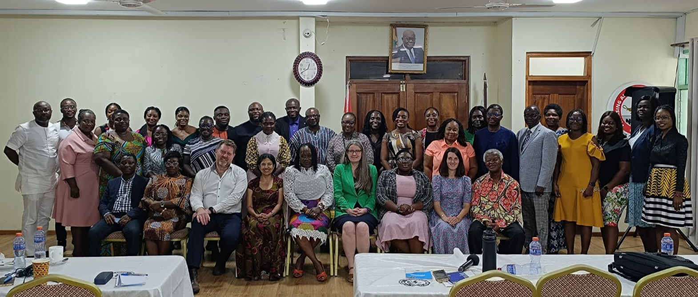
Thank you so much for hosting us!

Slide 35

End slide
global.fellowships@hee.nhs.uk

